Slide 1
Lecture 6 CUDA Global Memory
Kyu Ho Park
Mar. 21, 2017

Slide 2
Performance Tuning
To optimize the bandwidth utilization of a device,
-Aligned and coalesced memory access, (memory bandwidth)
-Sufficient concurrent memory operations are required. (memory latency)
To increase the concurrent memory access,
-Increasing the number of independent memory operations performed in each thread,
-kernel launch should be configured to get efficient parallelism.

Slide 3
Performance Tuning
Small threads per block exposes more parallelism to the GPU.
But when you have not enough thread per block, you can’t use the SM efficiently.
For example. Fermi GPU, the maximum number of concurrent blocks per SM is 8, and the maximum number of concurrent warps per SM is 48.
So, when you use 128 threads per block, there are 4 warps per block. So the maximum number of concurrent warps in the SM is 32 ! You can’t use the SM efficiently.

Slide 4
Parallelism
Task Parallelism:
It focuses on distributing functions across multiple cores.
Data Parallelism:
It focuses on distributing the data across multiple cores.
Data Partitions:
1.Block Partition:
Each thread takes one portion of data.
2.Cyclic Partition:
Each thread takes more than one portion
of the data.

Slide 5
Latency Hiding
Instruction Latency: the number of clock cycles between an instruction being issued and being completed.
Latency:
Arithmetic operations: 10~20 cycles
Global Memory Access: 400~800 cycles.

Slide 6
Little’s Law
L = λW, where
λ : longterm average effective arrival rate,
W : average time a customer spends in the system.
Number of Required Warps
=Throughput x Latency.
In pipeline, L (operations) = λ (IPC) W (instruction latency)

Slide 7
SM Parallelism Required to Maintain Full Arithmetic Utilization
GPU Model | Instruction Latency (Cycles) | Throughput (Operations/Cycle) | Parallelism (Operations)
Fermi | 20 | 32 | 640
Kepler | 20 | 192 | 3,830

Slide 8
Device Parallelism Required to Maintain Full Memory Utilization
GPU Model | Memory Instruction Latency(Cycles) | Bandwidth (GB/Sec) | Bandwidth (Bytes/Cycle) | Parallelism (KB)
Fermi | 800 | 144 | 92 | 74
Kepler | 800 | 250 | 96 | 77
Fermi TeslaC2070: Memory frequency: 1.566GHz

Slide 9
Unrolling a loop in C
CVCV
//Normal Loop
int i;
for( i=0;i<100;i++)
{
function(i);
}
//Unrolled Loop
int i;
for( i=0; i<100; i+=4)
{
function( i );
function(i+1);
function(i+2);
function(i+3);
}
number of compare reduces ¼
give 4 concurrency operation

Slide 10
Advantage of the unrolling loop?
In the unrolled loop, the condition i<100 is only checked 25 times instead of 100 times.
The reads and writes performed in each statement of each loop are independent, the memory operations can be issued simultaneously by the CPU.
Unrolling in CUDA, more concurrent operations are added to the pipeline leading to higher saturation of instruction and memory bandwidth. This provides the warp scheduler with more eligible warps that can help hide instruction or memory latency.

Slide 11
Perforemance Tuning:Unrolling loops
__global__ void readOffset(float *A, float *B, float *C, const int n, int offset) {
unsigned int i=blockIdx.x * blockDim.x + threadIdx.x;
unsigned int k= i + offset;
if( k<n) C[i] =A[k] + B[k];
}
__global__ void readOffsetUnroll4(float *A, float *B, float *C, const int n,
int offset){
unsigned int i=blockIdx.x*blockDim.x *4 + threadIdx.x;
unsigned int k = i + offset;
if(k+3*blockDim.x<n) {
C[i]=A[k] +B[k];
C[i + blockDim.x] =A[k+blockDim.x] + B[k+blockDim.x];
C[i+ 2*blockDim.x]=A[k+2*blockDim.x]+B[k+2*blockDim.x];
C[i+ 3*blockDim.x]=A[k+3*block*Dim.x]+B[k+3*blockDim.x];
}
}

Slide 12
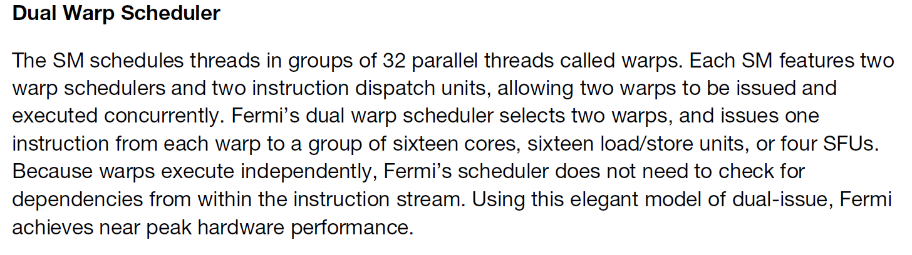
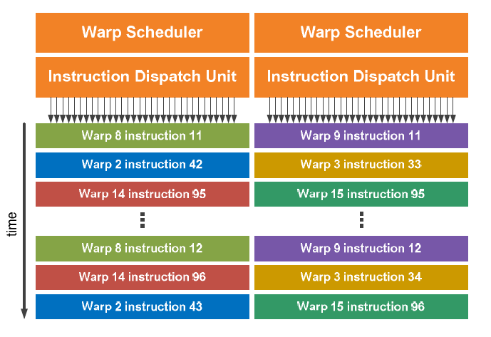

Slide 13
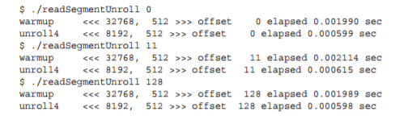
L1 cache enabled Performance

Slide 14
Matrix Transpose
0 | 4 | 8
1 | 5 | 9
2 | 6 | 10
3 | 7 | 11
0 | 1 | 2 | 3
4 | 5 | 6 | 7
8 | 9 | 10 | 11
Matrix
Transposed Matrix

Slide 15
Data Layout of Matrices
original matrix ( can be aligned, coalesced O)
0 | 1 | 2 | 3 | 4 | 5 | 6 | 7 | 8 | 9 | 10 | 11
transposed matrix ( can be aligned, Coalesced X)
0 | 4 | 8 | 1 | 5 | 9 | 2 | 6 | 10 | 3 | 7 | 11
void transposeHost(float *out, float *in,const int nx, const int ny){
for(int iy=0; iy<ny; ++iy){
for(int ix=0; ix<nx;++ix){
out[ix*ny + iy]=in[iy*nx+ix];
}
}
}

Slide 16
Read: by rows in the matrix, coalesced access.
Write: by columns in the transposed matrix, stride access which is the worst memory access pattern.
How to improve the bandwidth utilization:
Two approaches:
1.Read by rows and write by columns,
2.Read by columns and write by rows.

Slide 17
read by row, write by column
ix
nx
iy
ny
ix
(iy,ix)
iy
(ix,iy)
ix=blockIdx.x*blockDim.x +
threadIdx.x,
iy=blockIdx.y*blockDim.y +
threadIdx.y
ny
nx
Transposed Matrix
Matrix

Slide 18
Matrix Transpose
0 (0,0) | 4 (0,1) | 8 (0,2)
1 (1,0) | 5 (1,1) | 9 (1,2)
2 (2,0) | 6 (2,1) | 10 (2,2)
3 (3,0) | 7 (3,1) | 11 (3,2)
0 (0,0) | 1 (1,0) | 2 (2,0) | 3 (3,0)
4 (0,1) | 5 (1,1) | 6 (2,1) | 7 (3,1)
8 (0,2) | 9 (1,2) | 10 (2,2) | 11 (3,2)
(ix,iy)
Matrix
(iy,ix)
Transposed Matrix

Slide 19
Transpose: Read in Row and Write in Column
__global__ void transposeRow(float *out, float *in, const int nx, const int ny){
unsigned int ix=blockDim.x*blockIdx.x+threadIdx.x;
unsigned int iy=blockDim.y*blockIdx.y+threadIdx.y;
if(ix < nx && iy<ny){
out[ix*ny + iy]= in[iy*nx + ix];
}
}

Slide 20
read by column, write by row
ix
nx
iy
ny
ix
(ix,iy)
iy
(iy,ix)
iy=blockIdx.y*blockDim.y +
threadIx.y,
ix=blockIdx.x*blockDim.x +
threadIdx.x
ny
nx
Transposed Matrix
Matrix

Slide 21
Matrix Transpose
0 (0,0) | 4 (0,1) | 8 (0,2)
1 (1,0) | 5 (1,1) | 9 (1,2)
2 (2,0) | 6 (2,1) | 10 (2,2)
3 (3,0) | 7 (3,1) | 11 (3,2)
0 (0,0) | 1 (0,1) | 2 (0,2) | 3 (0,3)
4 (1,0) | 5 (1,1) | 6 (1,2) | 7 (1,3)
8 (2,0) | 9 (2,1) | 10 (2,2) | 11 (2,3)
(iy,ix)
(ix,iy)
Matrix
Transposed Matrix

Slide 22
Transpose Read by Column and Write by Row
__global__ void transposeCol(float *out, float *in, const int nx, const int ny){
unsigned int ix=blockDim.x*blockIdx.x+threadIdx.x;
unsigned int iy=blockDim.y*blockIdx.y+threadIdx.y;
if(ix < nx && iy<ny){
int tid = iy*nx + ix;
int newX = tid%ny;
int newY = tid/ny;
out[newY*ny + newX]= in[newX*nx + newY];
}
}

Slide 23
Which one is better?
Reads by rows and stores by columns
Reads by columns and stores by rows.
1) If L1 cache is disabled for loads
- these two implementations are theoretically identical!
2) If L1 cache is enable (L1 can be used in load but store)
- the second implementation should demonstrate better performance. While the reads performed by column will be uncoalesced (hence bandwidth will be wasted on bytes that were not requested), bringing those extra bytes into the L1 cache means that the next read may be serviced out of cache rather than global memory. Because writes are not cached in L1, the example that writes by column does not benefit from any caching

Slide 24
Upper and Lower Performance Bound
Upper Bound (best, may be memory bandwidth): Copy the matrix by loading and storing rows, which are all coalesced accesses.
The number of memory operations is the same
as that of the matrix transpose.
Lower Bound (worst, may be memory bandwidth): Copy the matrix by loading and storing columns, which are all stride accesses.
The number of memory operations is the same
as that of the matrix transpose.

Slide 25
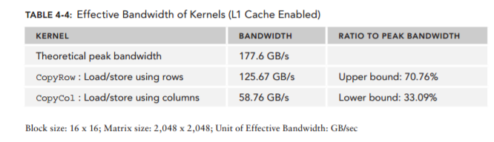

Slide 26
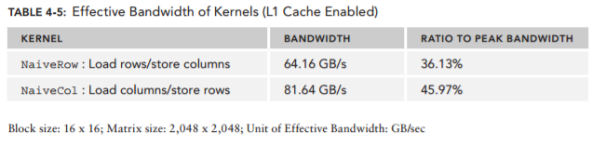
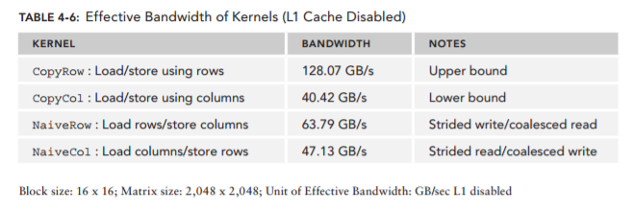
cpu L1 : temporal & spatial locality
gpu L1 : spatial locality

Slide 27
Unrolling Transpose
To improve the memory bandwidth of transpose, the unrolling transpose is to assign more independent work to each thread in order to maximize in-flight memory requests.

Slide 28
Row-based unrolling
__global__ void transposeNaive4Row(float *out, float *in, const int nx, const int ny){
unsigned int ix=blockDim.x*blockIdx.x+threadIdx.x;
unsigned int iy=blockDim.y*blockIdx.y+threadIdx.y;
unsigned int ti=iy*nx+ix;
unsigned int to=ix*ny+iy;
if(ix+3*blockDim.x < nx && iy<ny){
out[to]= in[ti];
out[to+ny*blockDim.x]=in[ti+blockDim.x];
out[to+ny*2*blockDim.x]=in[ti+2*blockDim.x];
out[to+ny*3*blockDim.x]=in[ti+3*blockDim.x];
}
}

Slide 29
Column-based Unrolling
__global__ void transposeNaive4Col(float *out, float *in, const int nx, const int ny){
unsigned int ix=blockDim.x*blockIdx.x+threadIdx.x;
unsigned int iy=blockDim.y*blockIdx.y+threadIdx.y;
unsigned int ti=iy*nx+ix;
unsigned int to=ix*ny+iy;
if(ix+3*blockDim.x < nx && iy<ny){
out[ti] = in[to]; out[ti + blockDim.x] = in[to+ blockDim.x*ny]; out[ti + 2*blockDim.x] = in[to+2*blockDim.x*ny]; out[ti + 3*blockDim.x] = in[to+3*blockDim.x*ny]; } }

Slide 30
Diagonal Transpose
Cartesian Coordinate
(0,0) 0 | (1,0) 1 | (2,0) 2 | (3,0) 3
(0,1) 4 | (1,1) 5 | (2,1) 6 | (3,1) 7
(0,2) 8 | (1,2) 9 | (2,2) 10 | (3,2) 11
(0,3) 12 | (1,3) 13 | (2,3) 14 | (3,3) 15
int bid=blockIdx.y*gridDim.x + blockIdx.x;

Slide 31
Diagonal Transpose
Diagonal Coordinate
(0,0) 0 | (0,1) 4 | (0,2) 8 | (0,3) 12
(1,3) 13 | (1,0) 1 | (1,1) 5 | (1,2) 9
(2,2) 10 | (2,3) 14 | (2,0) 2 | (2,1) 6
(3,1) 7 | (3,2) 11 | (3,3) 15 | (3,0) 3
(blockIdx.x , blockIdx.y)
int bid=blockIdx.y*gridDim.x + blockIdx.x;
Transformation from the Diagonal Coordinate( blockIdx.x, blockIdx.y)
to the Cartesian Coordinate ( block_x, block_y):
block.x=(blockIdx.x+blockIdx.y)%gridDim.x;
block.y=blockIdx.x;

Slide 32
Partition Camping
(0,0) 0 | (1,0) 1 | (2,0) 2 | (3,0) 3
(0,1) 4 | (1,1) 5 | (2,1) 6 | (3,1) 7
(0,2) 8 | (1,2) 9 | (2,2) 10 | (3,2) 11
(0,3) 12 | (1,3) 13 | (2,3) 14 | (3,3) 15
0 | 4 | 8 | 12
1 | 5 | 9 | 13
2 | 6 | 10 | 14
3 | 7 | 11 | 15
IN Data
OUT Data

Slide 33
Partition Camping
Requests to global memory are serviced by DRAM partitions.
Successive 256-byte regions of device memory are assigned to successive partitions. When using Cartesian coordinates to map thread blocks to data blocks, global memory accesses may not be evenly distributed among DRAM partitions, and a phenomenon called partition camping may occur.
In partition camping, memory requests are queued at some partitions while other partitions remain unused. Because the diagonal coordinate mapping causes non-linear mappings from thread blocks to the data blocks they process, strided accesses are unlikely to fall into a single partition, and performance improves as a result

Slide 34
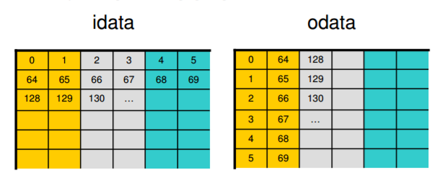
Partition Camping

Slide 35
Diagonal Coordinate
0 | 4 | 8 | 12
13 | 1 | 5 | 9
10 | 14 | 2 | 6
7 | 11 | 15 | 3
0 | 13 | 10 | 7
4 | 1 | 14 | 11
8 | 5 | 2 | 15
12 | 9 | 6 | 3
IN Data
OUT Data

Slide 36
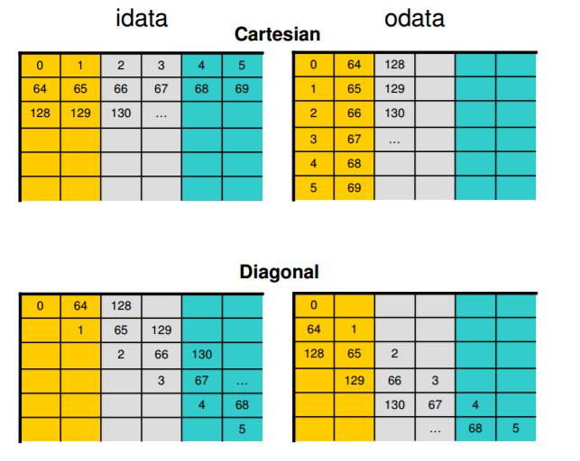
Cartesian coordinate
Read by row : use 3 partition each time
Write by column : use 1 partition each time
diagonal coordinate
Read by row : use 3 partition each time
Write by column : use 3 partition each time
Greg Ruetsch and Paulis Micikevicius,
“Optimizing Matrix Transpose in CUDA,”
NVIDIA.

Slide 37
More Parallelism with Thin Blocks
nx
ny
ny
nx

Slide 38
More Parallelism with Thin Blocks
For the case ‘transposeNaiveCol’ with GTX970
Block Size | Bandwidth(GB/s)
(32,32) | 72.32
(32,16) | 51.46
(32,8) | 77.67
(16,32) | 113.04
(16,16) | 111.08
(16,8) | 82.01
(8,32) | 127.60
(8,16) | 112.59
(8,8) | 73.72
A “thin” block improves the effectiveness of store operations by increasing the number of consecutive elements stored by a thread block as a result of a larger value in the innermost dimension of the thread block. Matrix transpose할때의 경우

Slide 39
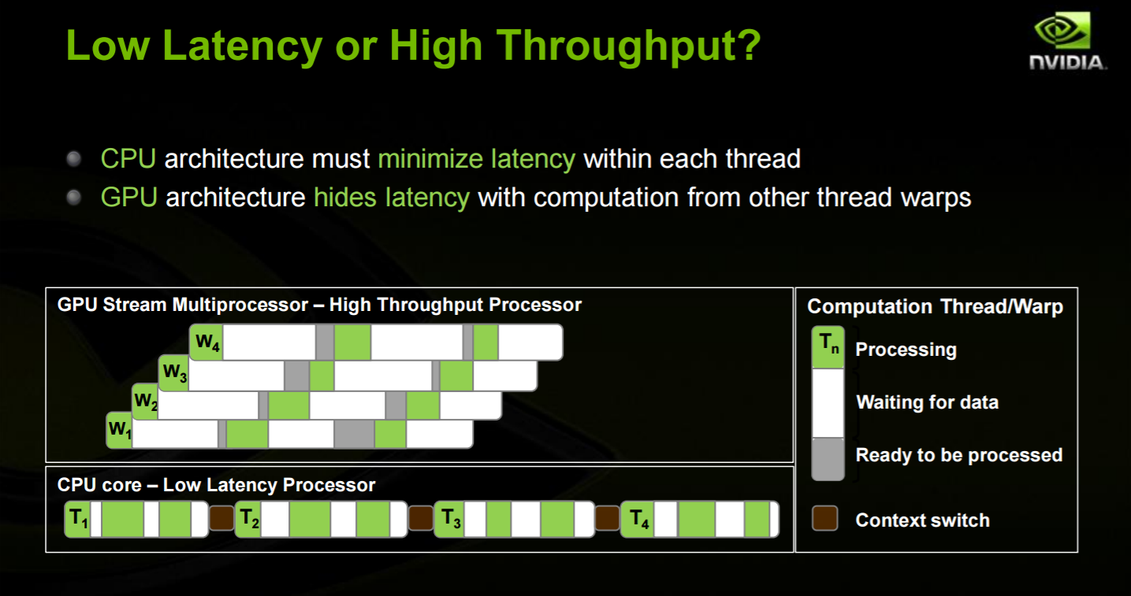

Slide 40
Presentation on Mar. 30, 2017
강상훈
NVIDIA Profiler User’s Guide, NVIDIA
김혜지
Greg Ruetsch and Paulis Micikevicius,
“Optimizing Matrix Transpose in CUDA,”
NVIDIA.

Slide 41


